Slide 1

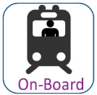




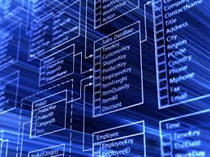

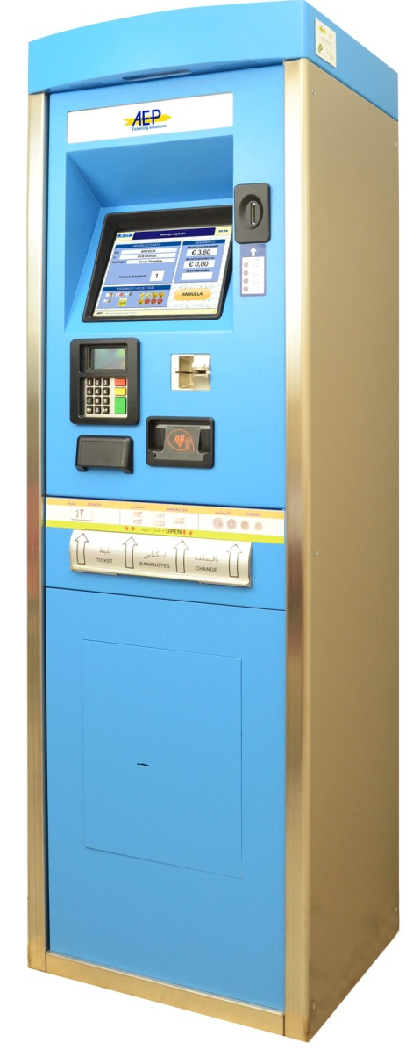

Buying ticket
at counters
Ticket at
retail shop
Ticket
Onboard
Ticket
online
Ticket
over phone
Buying ticket by
mobile devices
Buying ticket
By SMS
Information
update
via SMS
Information
update online
Information
update by
LED boards
Payment
at counters
Internet
(DMZ)
Internet
(DMZ)
Payment
By bank account, CC
LAN/WAN using VPN
SMS Gw
Ticket vending
machine
VPN
HW INFRASHTRUCTURE
MULTI-SERVICES INTEGRATION LAYER (WEB SERVICES)
Payment via
online payment
Companies (3rd PP)
Ticket Management
Customer Management
Information Server Management
Payment
Server Mgmt
External System
Of Vietnam Railway
Access/Presentation Layers
Using N+N
Promotion Management
Partner & Agent Management
Billing &
Financial
Security,
Administration, O&M,
Monitoring,
Logistics
Companies
Ticket Policies and Pricing Mgmt
Train Scheduler Management
Statistics and Reporting Module
Dynamic Seat Allocation
Resource Management
Settlement
Module
VNR
ERP
Application Layers
Using N+N
APPLICATION INTEGRATION - SOA (ESB)
Other system, etc.
DB ACCESS LAYER… Spring JDBC, Hibernate DAO
CENTRALIZED DB (ORACLE DB)
External System from Government
CUSTOMER DB
TICKET DB
TRAIN DB
ASSETS, INVENTORY DB…
DB Layer
Oracle RAC

